Slide 1


Food Insecurity and Undernutrition
Team name – Team knights
- Rushikesh Bharat Kumbhar - Ajinkya Sanjay Jadhav

Slide 2
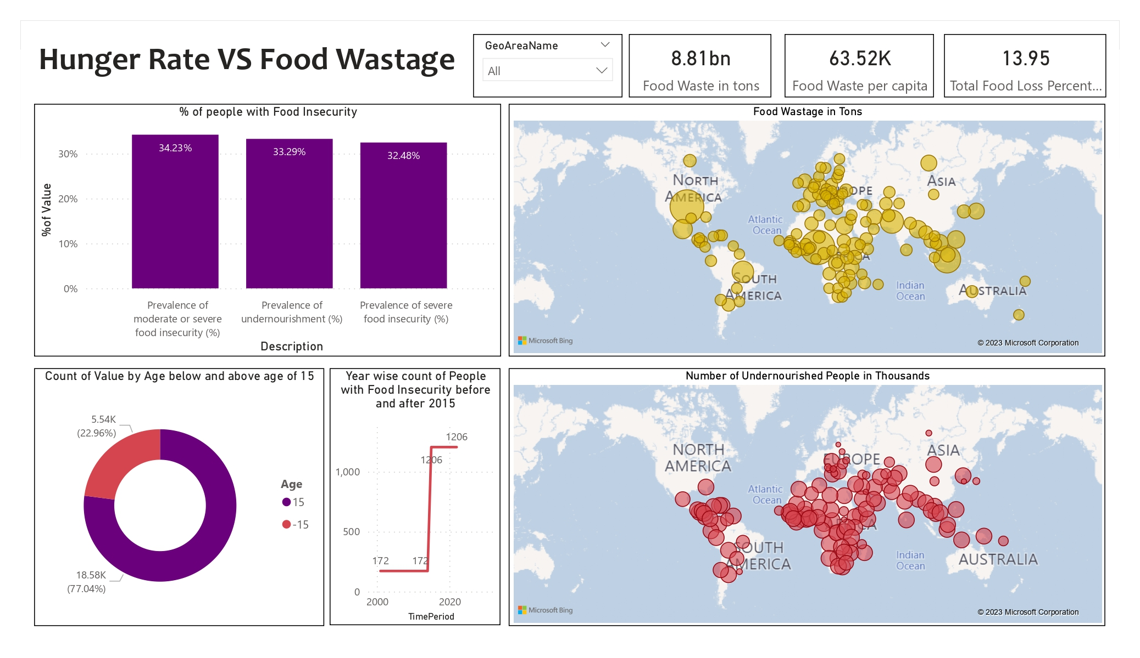
Problem Statement
To Find out if food wastage is directly proportional to the number of undernourished people in the geographical area
CDG Goals Selected:
Goal 2: Zero Hunger
Goal 12: Ensure sustainable consumption and production patterns
Background story:
Prevent Food Waste
Healthy Lifestyle Promotion
Food Security Programs

Slide 3

Insights
Food Wastage in Tons VS Number of undernourished People in each area
% of people with Food Insecurity in each country
Age-wise analysis of undernourished People
Year-wise count of People with Food Insecurity before and after 2015

Slide 4
Analysing Undernutrition w.r.t Food Wastage
Chart Details-
The first Geo chart represents the Food Wastage in Tons in each county and the Second Geo Chart represents the number of undernourished people in those same country
Key takeaways-
For Developed countries like the United States of America and European countries food wastage does not affect the hunger rate but in underdeveloped countries the percentage is high.
Nigeria and Ethiopia are the countries with the most undernutrition faced people.
Belarus and Luxembourg are the countries with the lowest rates of undernutrition as well as Food Wastage.

Slide 5
Age-wise analysis of undernourished People and Year-wise count of People with Food Insecurity before and after 2015
Chart Details-
The first get chart represents different rates of food insecurity and undernourishment.
The Second and Third chart represents the age-wise analysis of food insecurity and undernourishment.
Key takeaways-
33.23% of People from all over the world are facing moderate or severe food insecurity as well as 33.29% of people are in the phase of undernourishment.
Due to covid effect the food insecurity increased 10 Times than before 2015.

Slide 6




Insights Analysis
Insights for UN SDG on selected goals
Year-wise count of People with Food Insecurity before and after 2015 shows the number of people with food Insecurity increased after 2015
% of people with Food Insecurity in each country is higher in developing and poor countries
Age-wise analysis shows still there are 22.96% children face the hunger problems
Food wastage is directly proportional to the Hunger rate

Slide 7
Thank You

